Slide 1

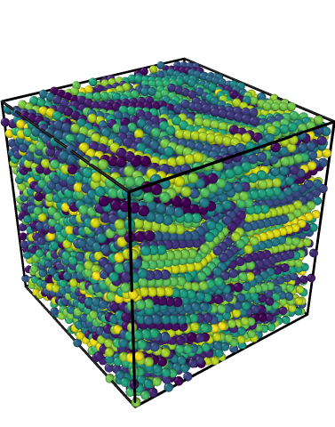

Simulating Liquid Crystals
Kit Gallagher
Supervisors: Prof Erika Eiser, Mr Jiaming Yu

Slide 2
Introduction
Introduction
Liquid Crystals
Phase Transitions
Order Parameters
DNA as a Liquid Crystal
Methods
Rigid Rod Simulations
Nunchuck Simulations
Conclusions

Slide 3
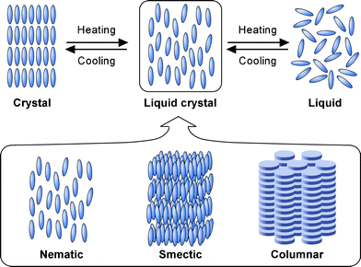
Liquid Crystals
Representation of the three liquid crystal phase classes, reproduced from Kato et al. [1] with permission.
[1] T. Kato, Y. Hirai, S. Nakaso, and M. Moriyama, Liquid-Crystalline Physical Gels, Chem. Soc. Rev. 36, 1857 (2007).

Slide 4
Phase Transitions
Lyotropic
Induced by changes in concentration
Entropically Driven Occurring in the absence of attractive intermolecular forces

Slide 5
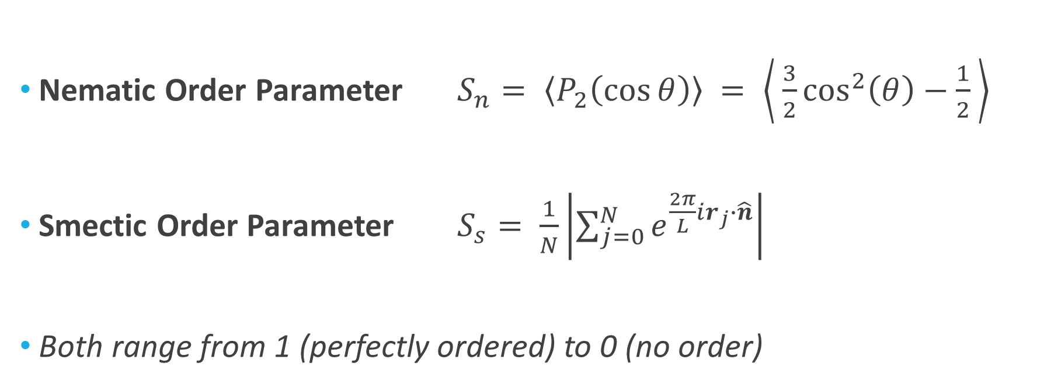
Order Parameters
Nematic Order Parameter $S_{n}= \left\langle P_{2}\left(\cos{θ}\right)\right\rangle = \left\langle \frac{3}{2}\cos^{2}\left(θ\right)−\frac{1}{2} \right\rangle$
Smectic Order Parameter $S_{s}= \frac{1}{N}\left|\sum_{j=0}^{N}{e^{\frac{2π}{L}ir_{j}∙\hat{n}}}\right|$
Both range from 1 (perfectly ordered) to 0 (no order)

Slide 6
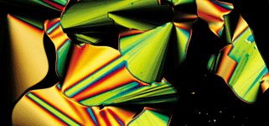
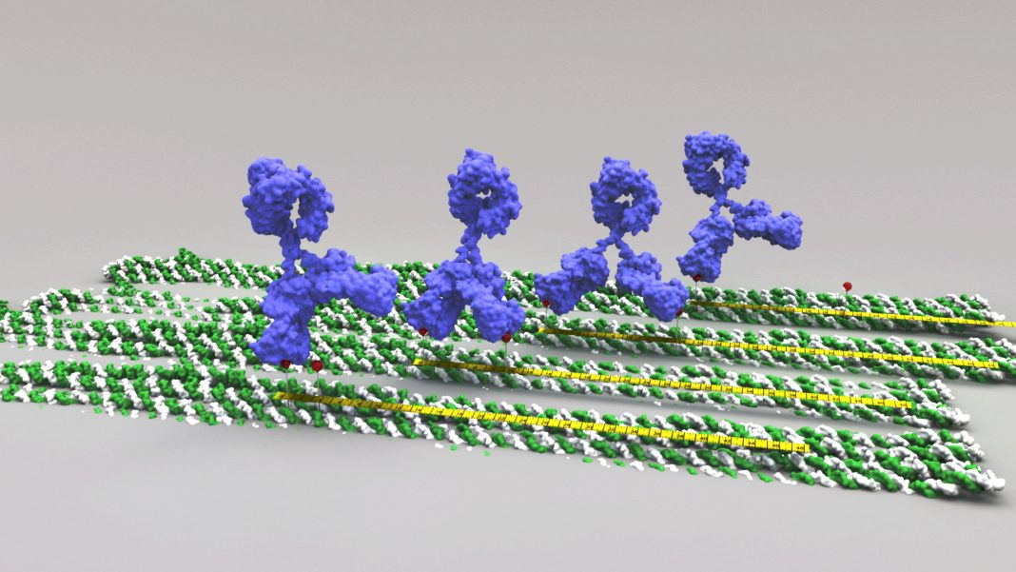
DNA as a Liquid Crystal
DNA Liquid Crystal, from Nakata et al. ²
DNA Origami, from Shaw et al. ³
² M. Nakata et al. End-to-End Stacking and Liquid Crystal Condensation of 6- to 20-Base Pair DNA Duplexes, Science 318, 1276 (2007). ³ A. Shaw et al. Binding to Nanopatterned Antigens Is Dominated by the Spatial Tolerance of Antibodies, Nature Nanotech 14, 184 (2019).

Slide 7
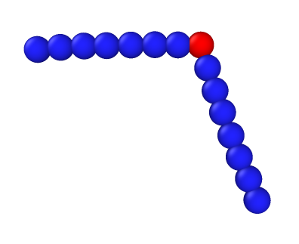
Methods
Introduction
Methods
Nunchuck Molecules
Simulation Structure
Rigid Rod Simulations
Nunchuck Simulations
Conclusions
θ

Slide 8
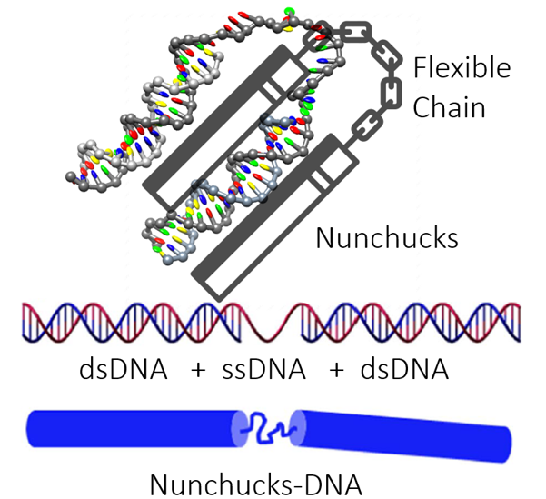
Nunchuck Molecules
Figure 4 (right): The implementation within LAMMPS, with the central red sphere representing the ss-DNA
θ
Figure 3 (left): Depiction of the analogy between the DNA mesogen and the nunchucks. Figure created by Jiaming Yu (Eiser Group, Cambridge).

Slide 9
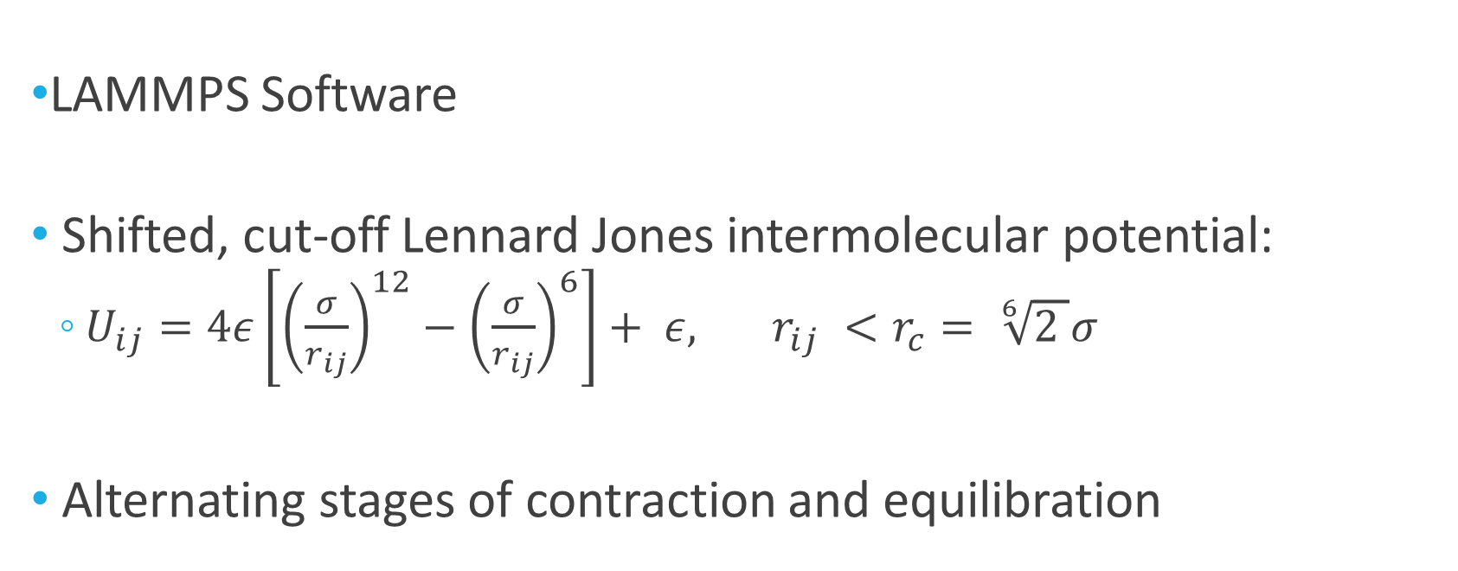
Simulation Structure
LAMMPS Software
Shifted, cut-off Lennard Jones intermolecular potential:
$U_{ij}=4ε\left[{\left(\frac{σ}{r_{ij}}\right)}^{12}−{\left(\frac{σ}{r_{ij}}\right)}^{6}\right]+ ε, r_{ij} <r_{c}= \sqrt[6]{2 }σ$
Alternating stages of contraction and equilibration

Slide 10
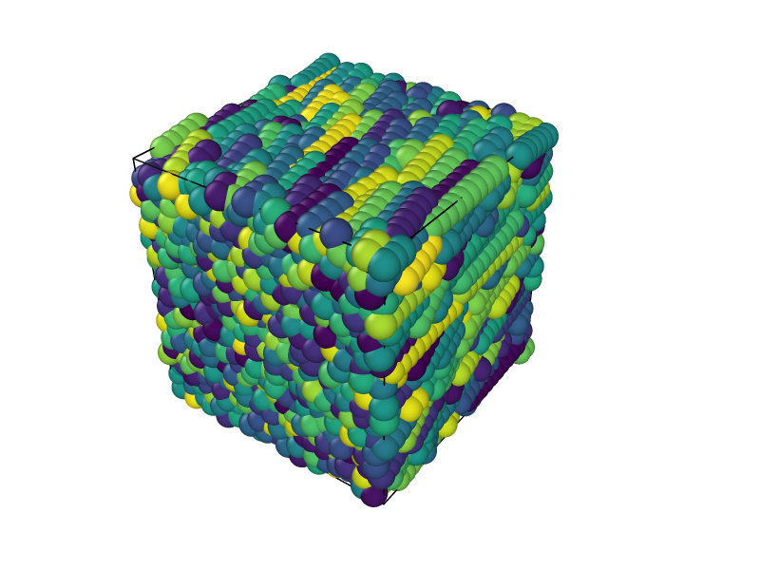
Rigid Rod Simulations
Introduction
Methods
Rigid Rod Simulations
Nematic Transition
Smectic Transition
Nunchuck Simulations
Conclusions

Slide 11
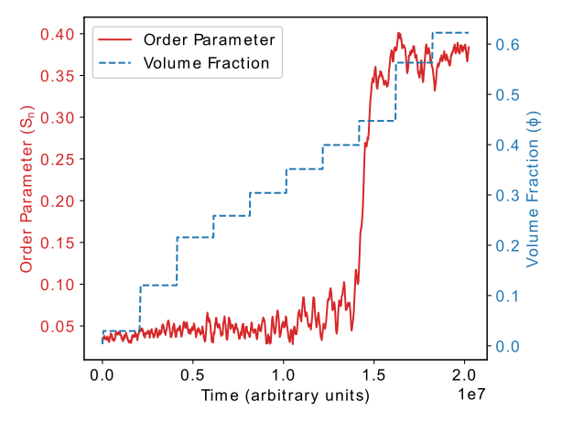
Nematic Phase Transition

Slide 12
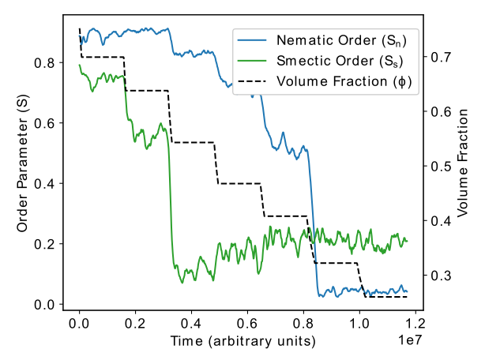
Smectic Phase Transition

Slide 13
Nunchuck Simulations
Introduction
Methods
Rigid Rod Simulations
Nunchuck Simulations
Fixed Rigidity
Fixed Angle
Dynamic Properties
Conclusions

Slide 14
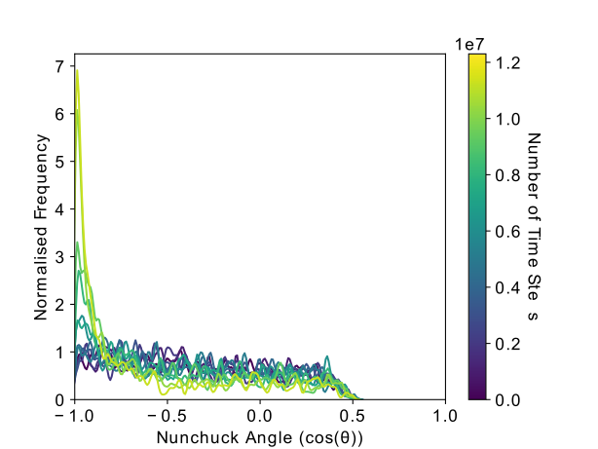
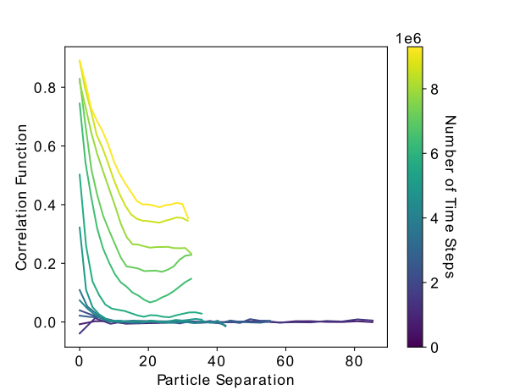
Fixed Rigidity

Slide 15
Fixed Angle

Slide 16
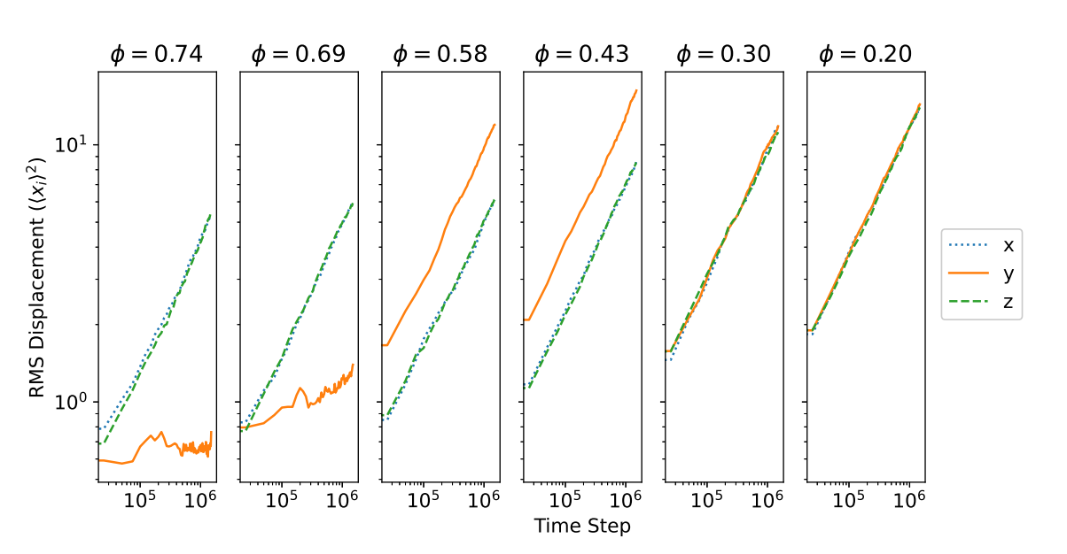
Dynamic Properties

Slide 17
Conclusions
Introduction
Methods
Rigid Rod Simulations
Nunchuck Simulations
Conclusions
Primary Findings
Further Work

Slide 18
Primary Findings
Rigid Rod Simulations
Nematic Phase in agreement with Onsager
Verification of Smectic Phase existence
Nunchuck Simulations
Formation of order through preferred angle (fixed rigidity)
Quasi-nematic phase formation in fixed angle case
Novel phase identification method through dynamic properties

Slide 19
Future Research
Extend simulation region to detect periodicity over greater length scales
Implementation of bending potential from OxDNA
Further application of dynamic property-based phase detection

Slide 20
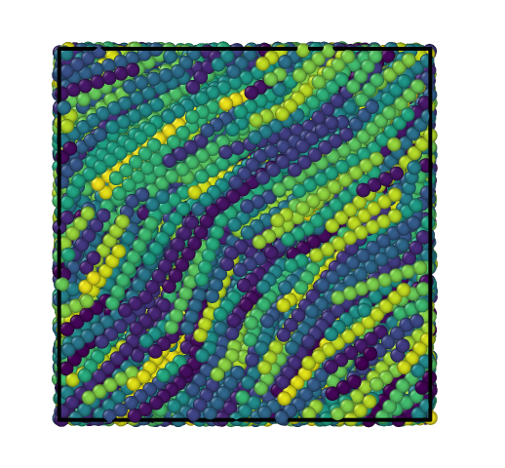
Thank you for listening

Slide 21
References
¹ T. Kato, Y. Hirai, S. Nakaso, and M. Moriyama, Liquid-Crystalline Physical Gels, Chem. Soc. Rev. 36, 1857 (2007).
² M. Nakata, G. Zanchetta, B. D. Chapman, C. D. Jones, J. O. Cross, R. Pindak, T. Bellini, and N. A. Clark, End-to-End Stacking and Liquid Crystal Condensation of 6- to 20-Base Pair DNA Duplexes, Science 318, 1276 (2007).
³ A. Shaw, I. T. Hoffecker, I. Smyrlaki, J. Rosa, A. Grevys, D. Bratlie, I. Sandlie, T. E. Michaelsen, J. T. Andersen, and B. Högberg, Binding to Nanopatterned Antigens Is Dominated by the Spatial Tolerance of Antibodies, Nature Nanotech 14, 184 (2019).

